Slide 1
أكـــــاديميــــة طــــويـــق
Artificial Intelligence Ethics

Slide 2
Discrimination and Ethical Implications in AI
Understanding BIAS and Implications
By: Dr. Afshan Hashmi

Slide 3
Course Objectives:
To understand the ethical implications of AI in decision-making, particularly in areas like hiring, healthcare, and law enforcement.
To explore regulatory frameworks such as GDPR, AI Act, and ECOA that address AI discrimination and promote fairness.
Course Learning Outcomes:
1.Students will be able to identify and analyze sources of bias in AI systems and their impact on fairness.
2. Students will demonstrate knowledge of legal and ethical frameworks that mitigate AI discrimination and ensure responsible AI development.

Slide 4

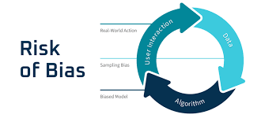
Understanding Bias in AI
Definition and Types of Bias: Bias in AI refers to systematic errors in machine learning models that lead to unfair outcomes. It can be classified into:
Data Bias: Occurs when training data is unrepresentative or imbalanced (e.g., facial recognition systems failing to recognize certain demographics).
Algorithmic Bias: Results from the way models process data and make decisions, often amplifying existing biases.
Human Bias: Introduced by the developers, researchers, or data annotators through subjective decisions.

Slide 5
Sources of Bias in AI Models:
Model Training
Feature Selection
Data Collection
Data Collection: Skewed or non-diverse datasets can lead to biased predictions.
Feature Selection: Choosing inappropriate or sensitive features (e.g., race or gender) can create biased outcomes.
Model Training: Biases in the learning process can reinforce disparities, especially if optimization prioritizes accuracy over fairness.

Slide 6

Real-World Examples:
Hiring Algorithms: Some AI-based hiring tools have discriminated against women due to biased training data.
Predictive Policing: AI systems predicting crime hotspots have reinforced racial biases due to historically biased police data.
Loan Approval Systems: AI models have unfairly denied loans to minority groups due to biased credit history data.

Slide 7
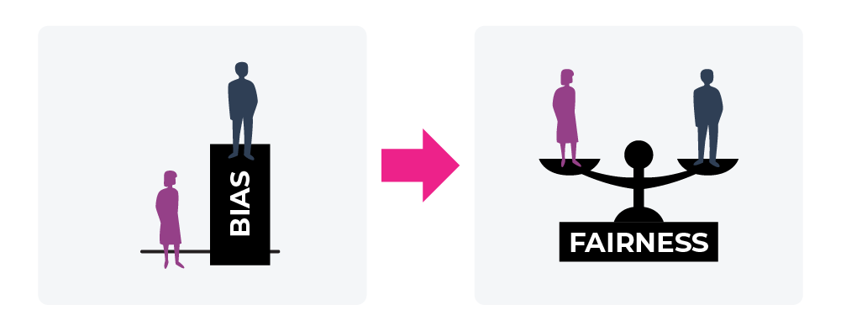
Fairness in AI Decision-Making
Fairness in AI refers to ensuring equitable outcomes across different groups. Two key perspectives include:
Group Fairness: Ensures that different demographic groups (e.g., gender, race) receive similar treatment.
Individual Fairness: Ensures that similar individuals are treated equally regardless of their group identity.

Slide 8
Fairness Criteria:
Demographic Parity
Equal Opportunity
Fairness
Criteria
Equalized Odds
Demographic Parity: Ensures that the same proportion of each group receives a positive outcome.
Equal Opportunity: Requires that qualified individuals across different groups have the same chance of a positive outcome.
Equalized Odds: Ensures that different groups have similar false positive and false negative rates.

Slide 9
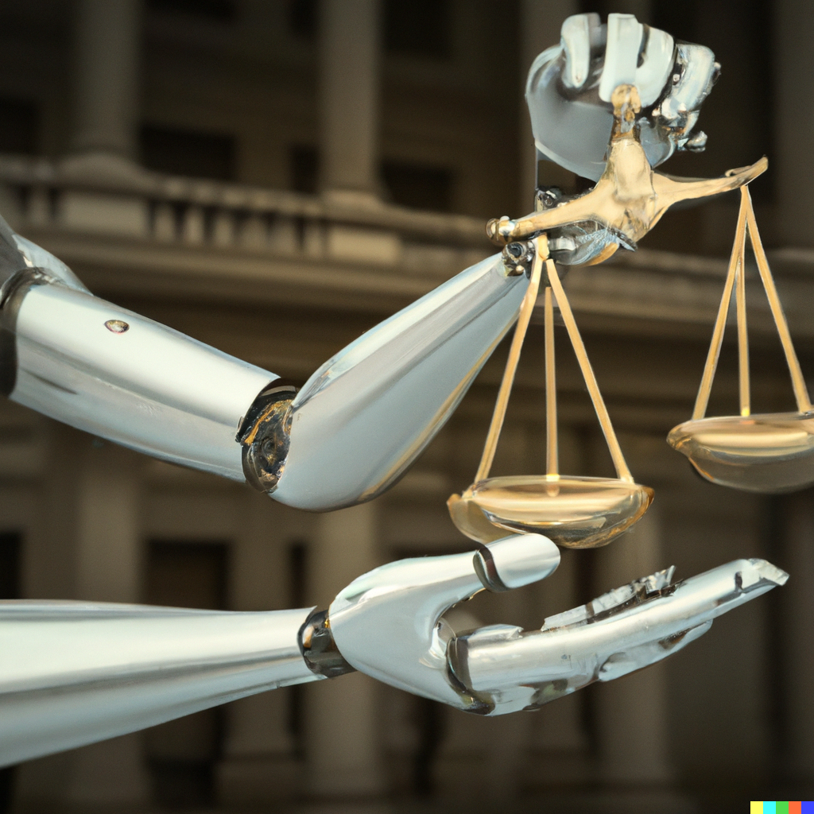
Trade-offs Between Accuracy and Fairness:
Increasing fairness might slightly reduce model accuracy since fairness constraints modify predictions.
Balancing accuracy and fairness is crucial in high-stakes applications like healthcare, hiring, and criminal justice.
This Photo by Unknown Author is licensed under CC BY

Slide 10
Discriminatory Outcomes in AI
AI systems can unintentionally produce discriminatory outcomes in various domains due to biases in training data, model design, or decision-making processes.
Hiring: AI-driven recruitment tools may favor certain demographics over others, as seen in Amazon’s hiring algorithm, which showed bias against women.
Lending: Credit scoring algorithms may systematically disadvantage minority groups due to biased historical data.
Healthcare: AI models trained on limited demographic data may misdiagnose conditions in underrepresented groups.
Policing: Predictive policing models have been criticized for reinforcing racial bias by over-policing certain communities based on biased historical crime data.

Slide 11
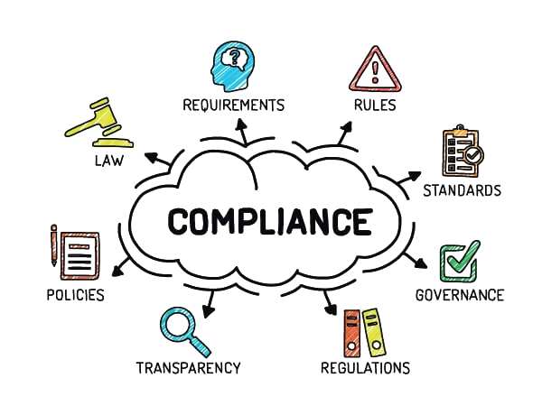
Legal and Ethical Frameworks for Preventing AI Discrimination
To mitigate discrimination, governments and organizations have developed ethical and legal frameworks. These frameworks ensure AI systems are transparent, accountable, and fair.
Ethical Guidelines: Encourage fairness, transparency, and accountability in AI decision-making.
Bias Audits: Regularly testing AI models for discriminatory patterns before deployment.

Slide 12
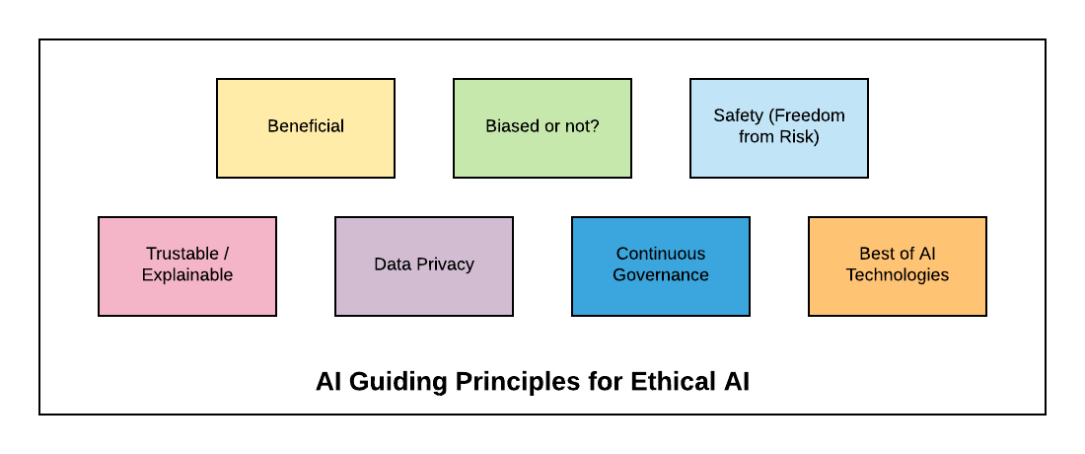
Regulatory Guidelines
Several regulations have been introduced to prevent AI-related discrimination:
General Data Protection Regulation (GDPR): Enforces transparency in AI decisions and grants users the right to explanation and data protection.
AI Act (EU): Proposes stricter regulations on high-risk AI applications to prevent bias and discrimination.
Equal Credit Opportunity Act (ECOA - US): Ensures fair lending practices by prohibiting discrimination based on race, gender, or age in credit decisions.
These frameworks help establish fairness, reduce harm, and hold AI developers accountable for ethical AI deployment.

Slide 13
RECAP
AI systems can lead to discriminatory outcomes in hiring, lending, healthcare, and policing due to biased training data and flawed algorithms.
Bias in AI can arise from multiple sources, including data collection, feature selection, and model training.
Fairness in AI decision-making is crucial and involves balancing accuracy with ethical considerations.
Legal and ethical frameworks help prevent AI discrimination by promoting transparency and accountability.
Regulatory guidelines like GDPR, AI Act, and ECOA enforce fairness and protect individuals from biased AI-driven decisions.
Bias audits and fairness metrics are essential for evaluating and mitigating discrimination in AI models.
Developers and organizations hold responsibility for ensuring ethical AI deployment and minimizing harmful societal impacts.

Slide 14

Check your Knowledge
Click Here

Slide 15

















الشراكات العالمية

Slide 16
شــــــكــــرًا لكــــــم
THANK YOU

